Slide 1

Stock Price Trend Prediction Using Machine Learning
Presented by :
Shon Khundiashvili
Netanel Yomtovian

Slide 2
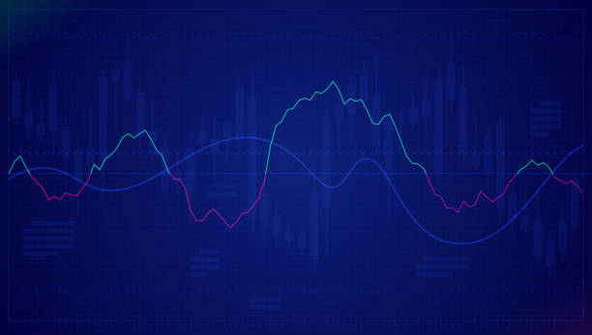
Abut the project
Why did we choose this topic?
First of all, due to the corona virus spread the stock prices change everyday dramatically.
We like this topic and interested about stocks and its prices. In conclusion, we decided to investigate what are the reasons for the change of stock prices and what can effect the price of the stock.
We personally invest in the capital market and we have always been interested in knowing what are the characteristics through which the stock price trend can be predicted.
.

Slide 3

Crawling
Using Beautiful Soup and Selenuim library.

Slide 4
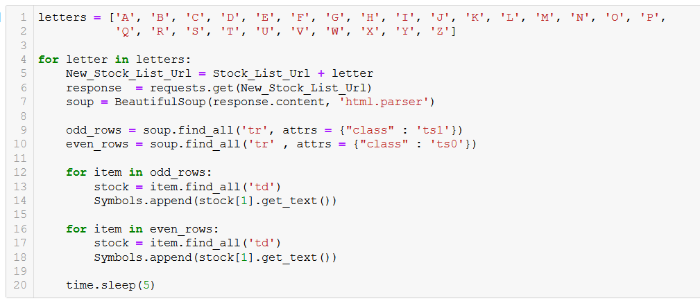
Step 1
Crawling the list of all stocks in Nasdaq with their Sector names
We created two arrays with the name 'Symbols' and 'Sectors' and appending to them each stock data.

Slide 5
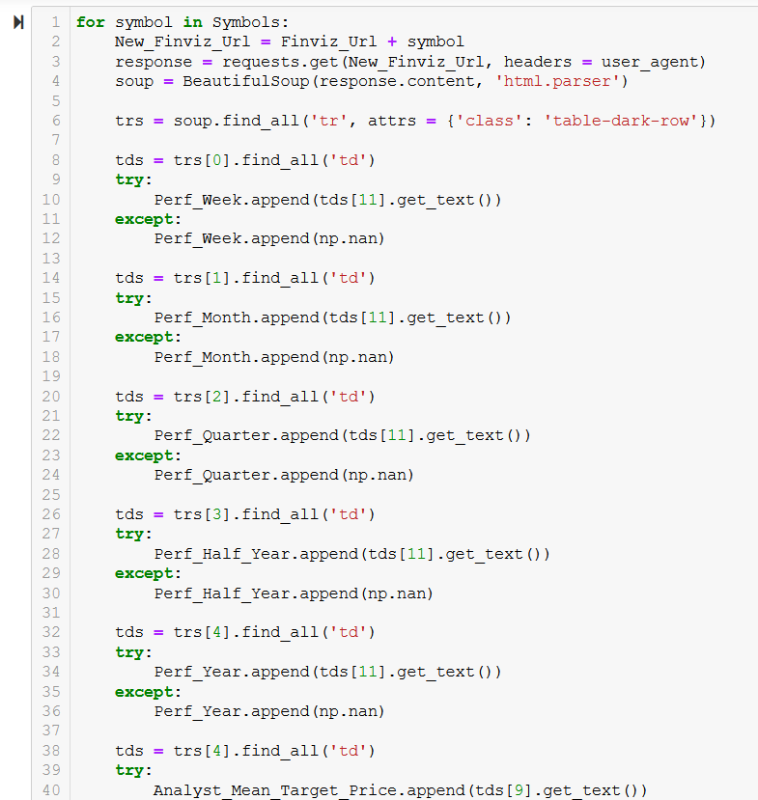
Step 2
Crawlig Data for 15 columns:
​ Avg_50 - the average stock price in 50 last days.
​ Avg_200 - the average stock price in 200 last days​.
Week_52_High - Highest price in last 50 days​.
Week_52_Low - Lowest price in last 50 days​
Perf_Month - the changes price value in last month (%)​
Perf_Quarter - the changes price value in last quarter (%)​
Perf_Half_Year - the changes price value in last half year (%)​
Perf_Year - the changes price value in last year (%)​

Slide 6
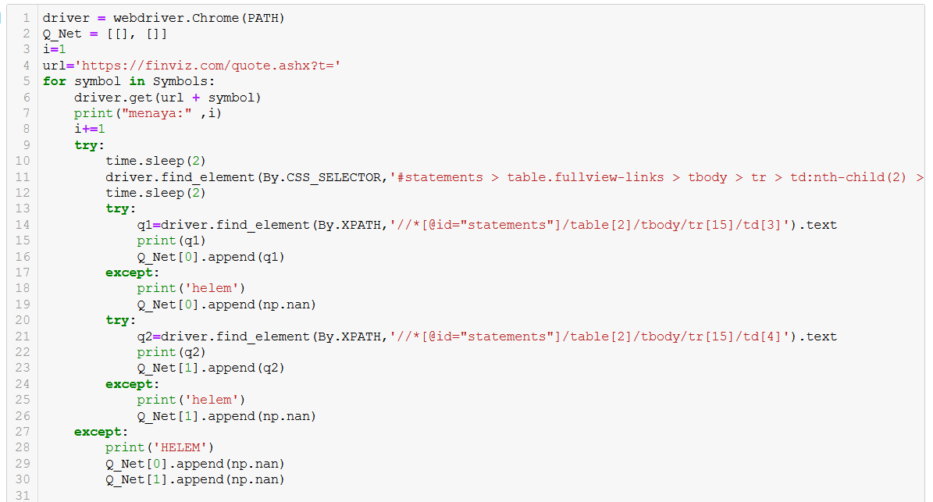
Step 2
Perf_Week - The changes price value in last year (%)
Avg_3_Month –The average price in last 3 month.
Vol_Avg_10_Day – The volume average in last 10 days
Vol_Avg_3_Months - The volume average in last 3 month
Current_Stock_Price – The current stock price
Held_By_Institusion - Percentage of the stock held by the institutions
Analyst_Mean_Target_Price - Target price presented by analysts for the coming year

Slide 7
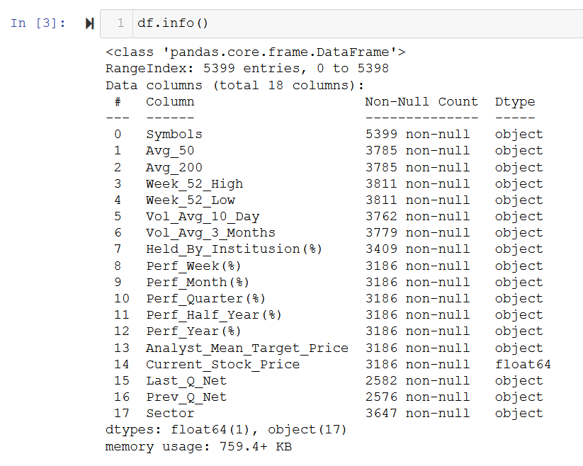
OUR DATA FRAME
In total we collected 5399 stocks

Slide 8
External Resources
Yahoo finance - https://finance.yahoo.com/
Finviz - https://finviz.com/
ADVFN - https://www.advfn.com/nasdaq/nasdaq.asp

Slide 9

Stock market
The stock market or equity market is the market for the trading of company stock (shares).
Share / Stock
Shares represent a fraction of ownership in a business. The common feature of all these is equity participation. Different classes of shares have different voting rights.
What is stock value per share?
The market value per share is a company's current stock price, and it reflects a value that market participants are willing to pay for its common share.

Slide 10

Handling Missing Data

Slide 11
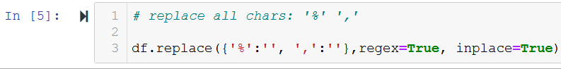
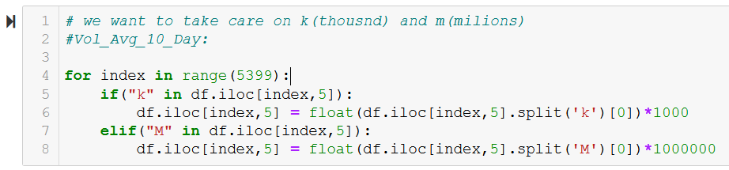
Understanding the data: Data Types, missing data, mean, unique, count, etc...​
Replacing all " ," --> "" "%" --> "" . In order to convert every data types to float. ​
The columns "Vol_Avg_10_Day" and "Vol_Avg_3_month" included the signs "k"​
(thousand) "m" (milions). In order to deal with this case we found all the cells that​
Including 'k' or 'm'. With the sign 'k' we multiplied by thousand and with 'm' we multiplied by million.

Slide 12
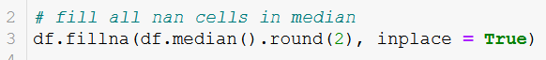
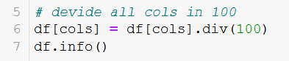
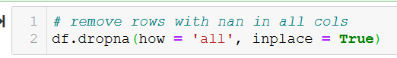
Filling all the cells with Nan by the median of specific columns:
Dividing all the columns that were presented with percent sign by 100
We removed all the rows that all of them contained 'Nan'
We have added a new column to the dataframe to indicate what are the changes in the stock price compared to the average over the last 200 days
.

Slide 13

Visualizations

Slide 14
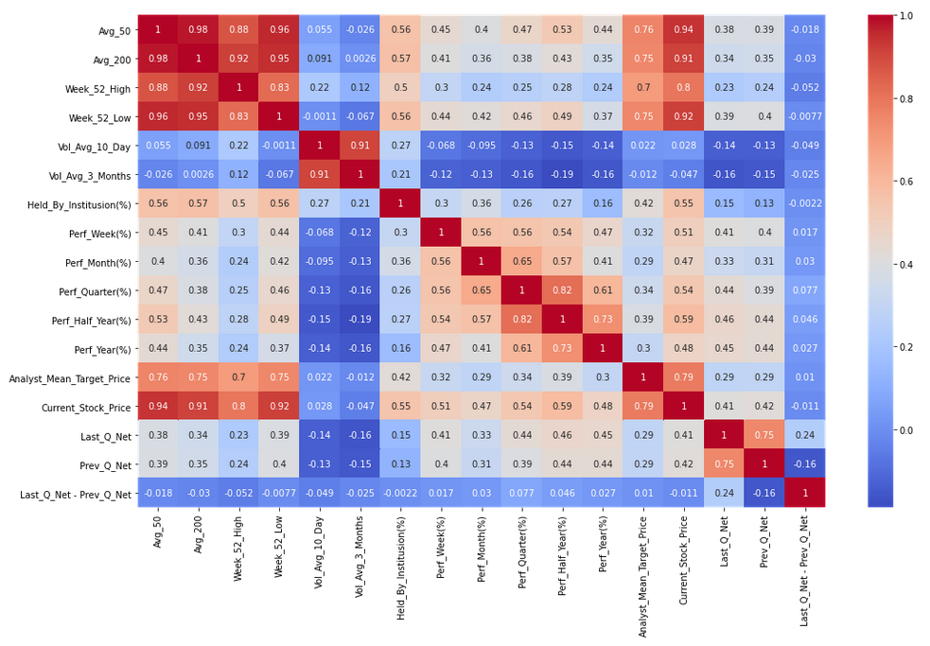
The general correlation between all our columns and rows in data frame.

Slide 15
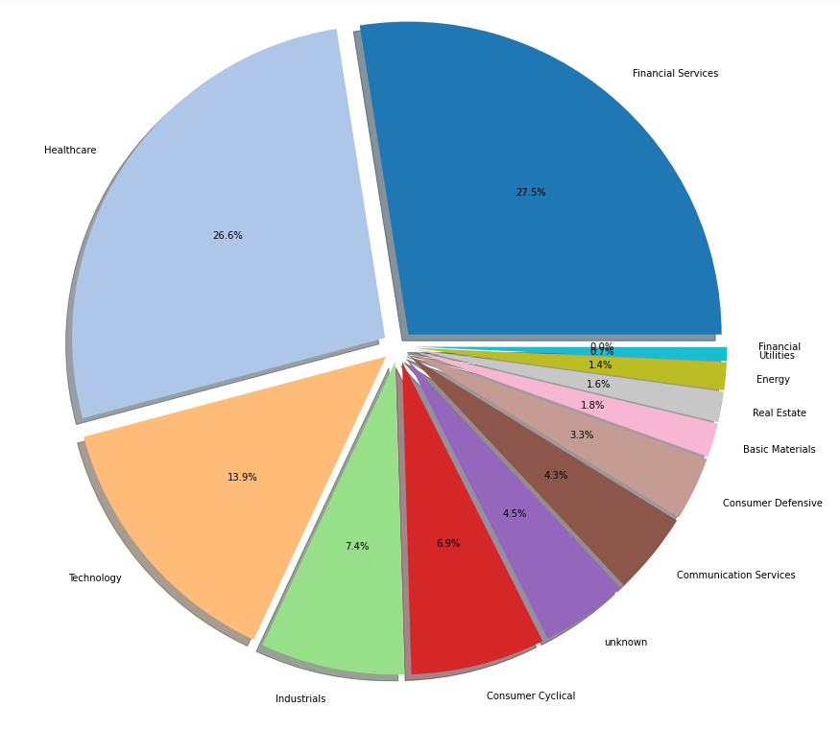
Dividing our pie plots by sectors

Slide 16
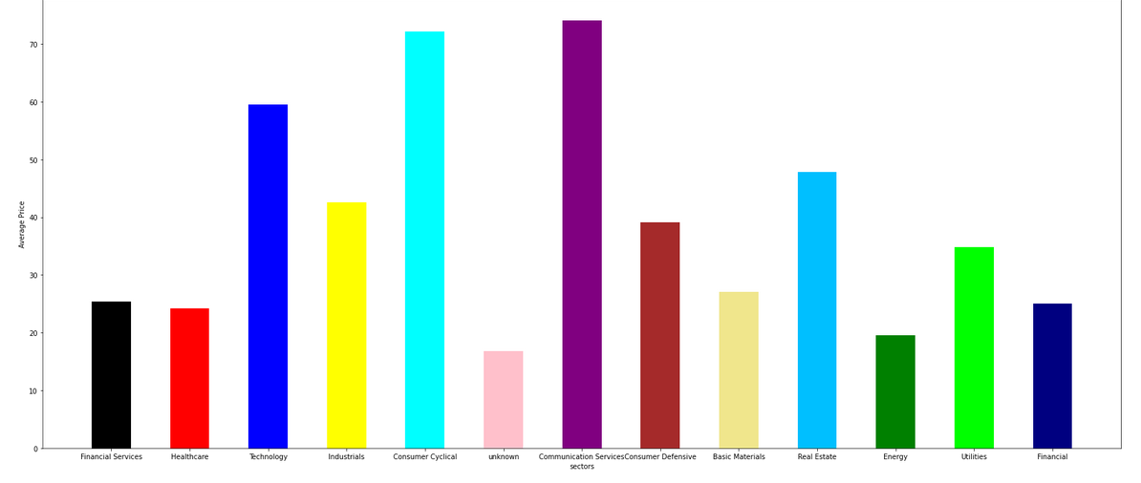
Visualizing the increase the average of all prices in each sector

Slide 17
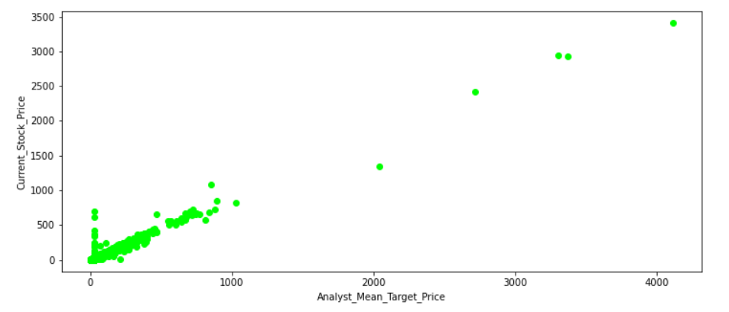
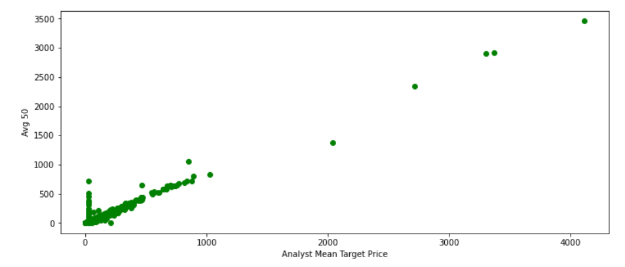
We can see have strong correlation between the 'Analyst mean target price' and 'Current stock price'
As the analyst mean target price increases, the price of the stock increases as well
Explanation:
As the recommendation of the stock is high, more people would be interested to buy this stock. in conclusion, from this reason the average of the stock is getting higher.

Slide 18
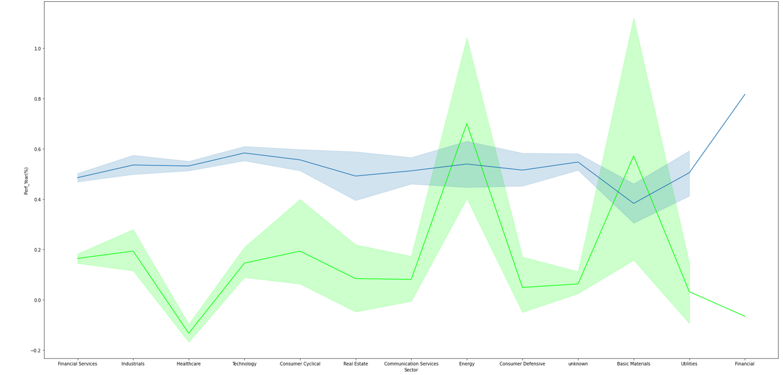
We wanted to check if there is a connection between the percentage of 'Held_By Institutions' and the changes of the stock for the last year.
it is easy to see that there is no connection between two

Slide 19
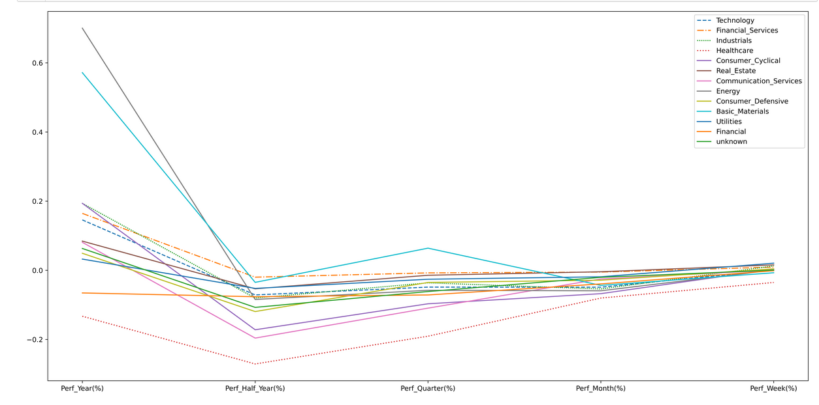
From this plot graph it is visible that all the sectors have dramatically decreased due to the corona virus new wave in the last year.
Important to mention: that there are events beyond our control that can cause drastic changes in the entire space of the stock market

Slide 20
Machine Learning

Slide 21
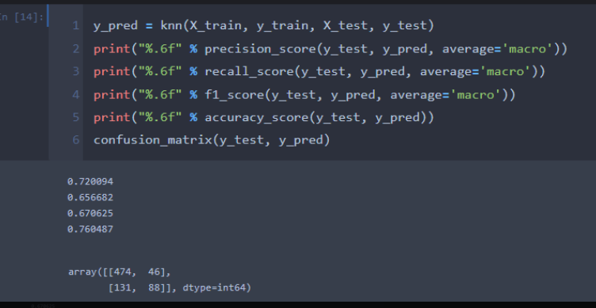
Our label is "Predict_Inc_Dec" column, as our research question refers to whether the trend of the price of the stock will increase or decrease.
We chose to apply KNN and Decision Tree - Supervised Learning for classification problems – categoric label.
Before the feature engineering, our label column contained more ‘0’ than ‘1’ and we normalized it.​ after the normalization the accuracy score is 76%

Slide 22
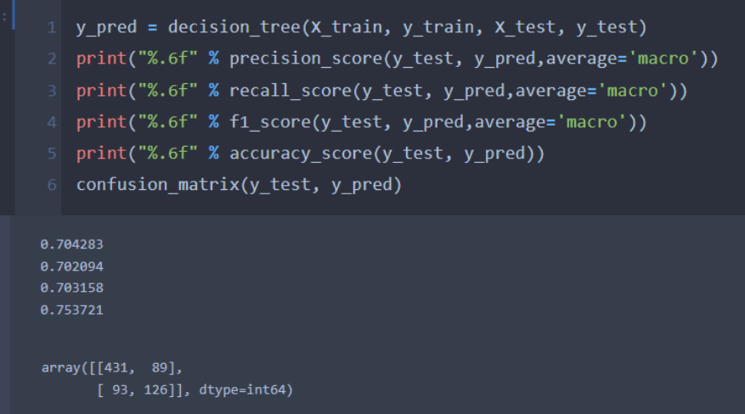
Steps:
We added a new label by the name “Predict_Inc_Dec”. The column contains numbers ‘1’ or ‘0’. According to the formula we checked the updated price of the stock with a previous price, if the updated price Is higher than the previous price filling label with value 1, else with 0.
For the model section we used two kind of machine learnings:
The first one is KNN with the score of 76% and the second one is Decision Tree with the score 70%
KNN Model
Decision model

Slide 23
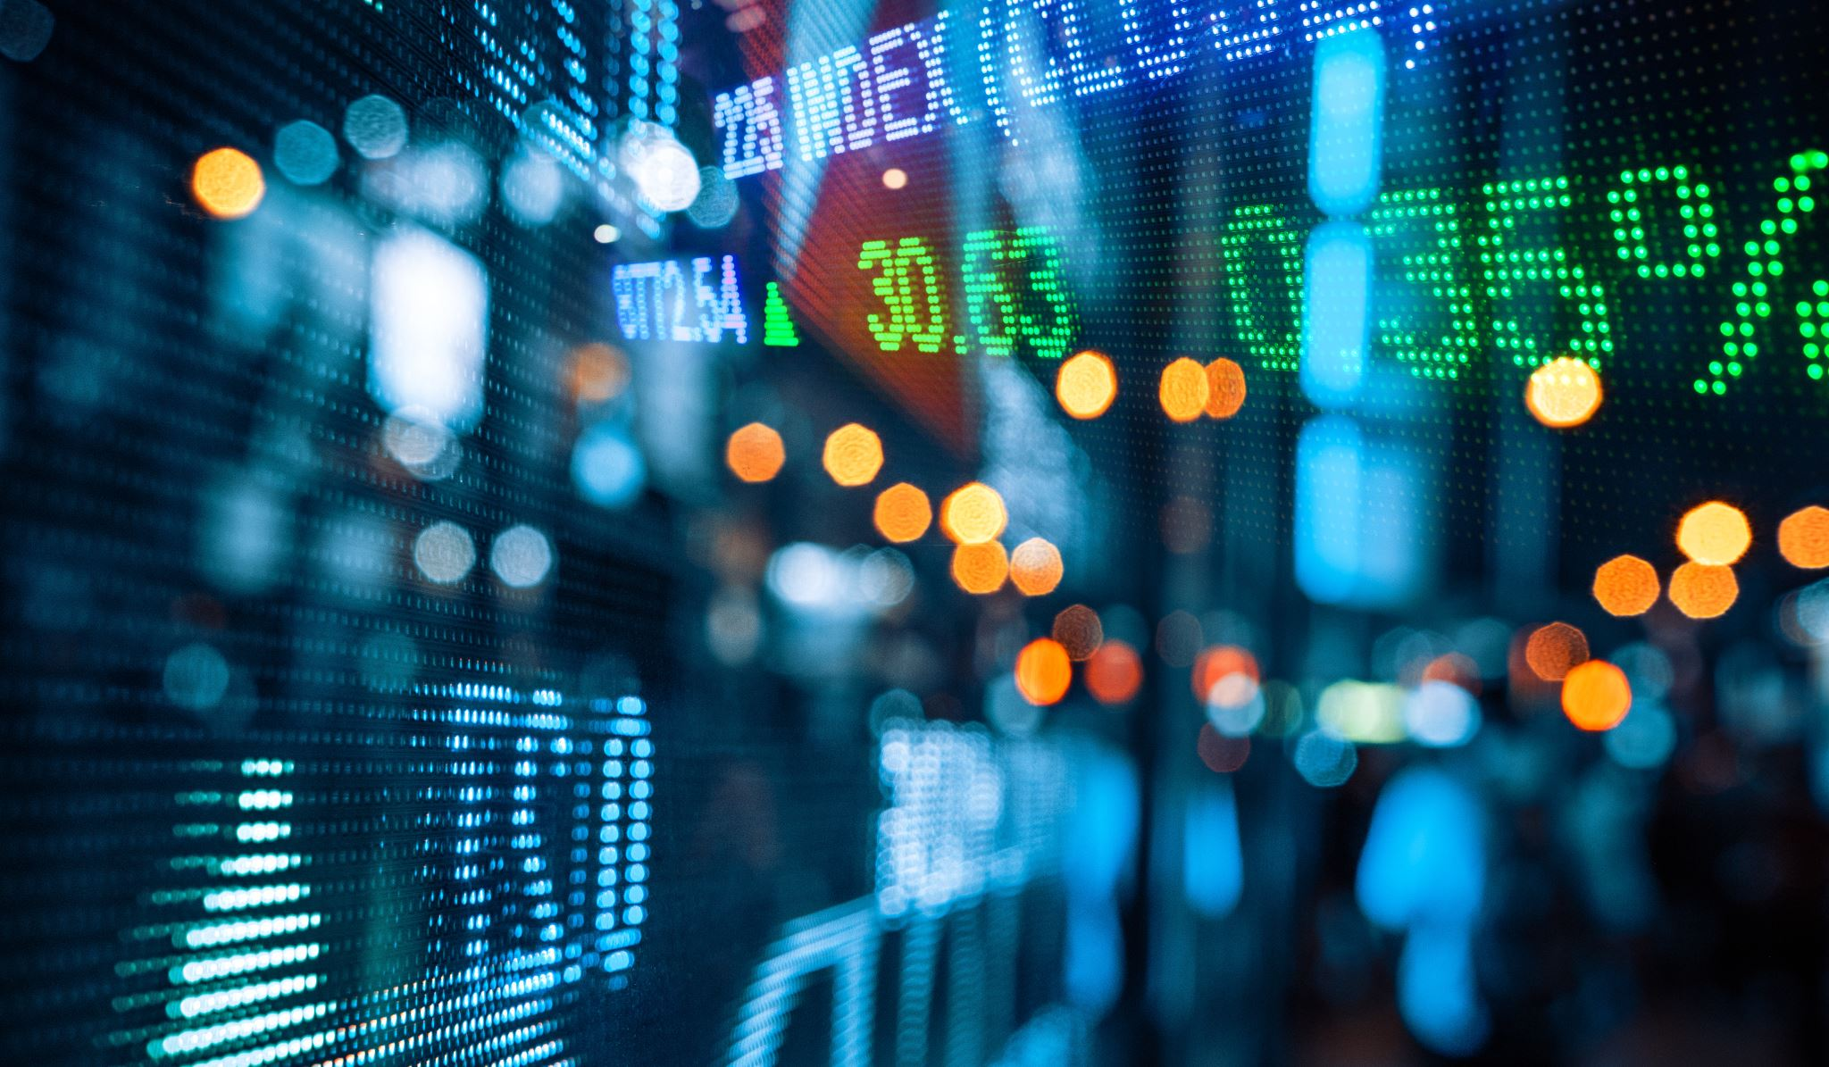
Thank you ☺

